Slide 1

SMART INDIA HACKATHON 2026
Problem Statement ID - SIH26006
Problem Statement Title– Intelligent Freight Forecasting for Optimized Vessel Chartering & Bulk Cargo Procurement
Theme - Transportation and logistics
PS Category - Software
Team ID-
Team Name - RouteX

Slide 2
NAVORA
Intelligent Freight Forecasting and Vessel Optimization
RouteX
What’s Broken Today?
Proposed Solution:-
A smart platform that helps companies make better shipping and cargo booking decisions.
Provides freight cost forecasts for upcoming days and weeks.
Suggests the most suitable vessel based on cargo quantity and port conditions.
Allows users to compare different shipping options before making a decision.
Shows possible risks such as fuel price changes, weather conditions, and port delays
01
Freight decisions are reactive
02
Vessel selection is fragmented
03
Voyages are optimized in isolation
“What-if” risks are hard to quantify
04

Slide 3







TECHNICAL APPROACH
RouteX
Data sources:
Freight, fuel, commodity, port, weather, vessel
Tech Stack
Python Pandas NumPy FastAPI React
PostgreSQL Docker
Data processing:
Pandas, NumPy
1. Data Collection
  Gather freight rates, fuel prices, vessel information, port conditions, and weather data.
2. Data Processing & Analysis
  Organize and analyse the collected data to identify market trends and operational constraints.
3. Decision Engine
  Compare shipping options, evaluate vessel suitability, estimate costs and risks, and generate recommendations.
4. Dashboard & Visualization
  Present forecasts, vessel recommendations, risk analysis, and shipping strategies through an interactive dashboard.
ML algorithms:
Prophet, XGBoost, LSTM
Market decision
Buy / Wait / Avoid
Vessel Decision
feasibility + ranking
Voyage optimization
Cost, idle time
Risk and Dashboard
monitoring

Slide 4
FEASIBILITY AND VIABILITY
RouteX
Around 95% of external trade by volume and 68% by value is transported by sea.
Ministry of Ports, Shipping and Waterways
~855 MT of Cargo handled by 12 major ports, FY25
Press Release FY 2024-25
49.5 hrs of vessel turn around, FY25
Press Release Page
16.5% time is spent idle
Press Release FY 2024-25
FEASIBILITY
Can we build it?
1. Data - Freight, fuel, commodity, ports
2. ML - Prophet, XGBoost, LSTM
3. Optimization – Vessel constraints, port constraints, weather conditions
4. Deployment - FastAPI, React, PostgreSQL
VIABILITY
Will it create value?
When – Buy / wait / avoid booking window
Which – Feasible vessel, port
How – Voyage scheduling and optimization
What if – Fuel, congestion, weather analysis

Slide 5
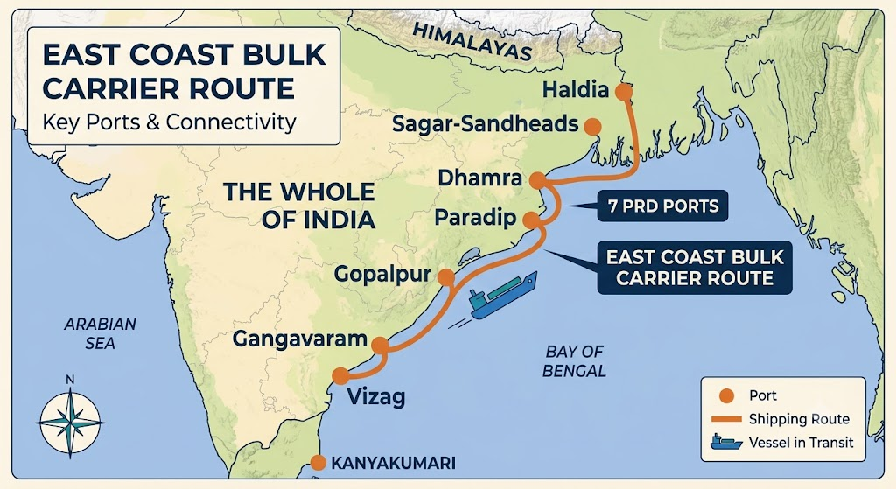
IMPACT AND BENEFITS
RouteX
The scale of opportunity
855 MT, 95% trade volume, 1.59 BT, and the 96 to 49.5 hrs / 16.3% idle stat
"MoPSW, FY 2024-25 - decade-long national trend"
Lower fuel consumption and freight costs
Reduced demurrage and vessel time
Faster decisions
Improved cargo flow
Reduced operational uncertainty
What Navora targets to deliver you?

Slide 6
RESEARCH AND REFERENCES
RouteX
Research & References
SIH 2026 Problem Statement – SIH26006
SIH26006 Problem Statement
Ministry of Ports, Shipping & Waterways (MoPSW) – Annual Reports
MoPSW Annual Reports
Ministry of Shipping & Waterways Press Release
Press Release FY 2024-25
MoPSW Annual Report 2025–26
Annual Report 2025–26
Indian Port Statistics & Cargo Traffic Reports
Port Reports & Statistics
Visakhapatnam Port Authority – Annual Reports
Visakhapatnam Port Reports
Paradip Port Authority – Port Infrastructure & Operations
Paradip Port Authority
UNCTAD Review of Maritime Transport
UNCTAD Maritime Transport Reports
Baltic Exchange – Baltic Dry Index (BDI)
Baltic Dry Index Data

